Slide 1
WORDZONE
Capstone Project
Presenter –
Ritveak dugar – 16bit0407

Slide 2
What is WordZone?
It is a place where user can execute multiple word related queries and by using the data generated by the user, Wordzone suggests new words to the user to learn.
It is a place where one can Find, understand, know and Learn words.
And hence it is a playground where users can explore and improve their vocabulary

Slide 3
What does it have?
It has Four parts:
Find Zone - Where user can find words for crossword, scrabble and rhymes.
Understand Zone – Where user can understand their word.
Knowledge Zone – Where user can know more words related to the entered word, like synonyms, antonyms etc.
Learning Zone – Where user can learn new words on the basis of their vocabulary

Slide 4
Tech Stack
PROGRAMMING LANGUAGE :
PYTHON
KIVY
TOOLS AND LIBRARIES:
NLTK
SPELL CHECKER
PRONOUNCING
DATAMUSE AND OXFORD API
WORDFREQ
PICKLE
TRAINING MODEL
LSTM

Slide 5
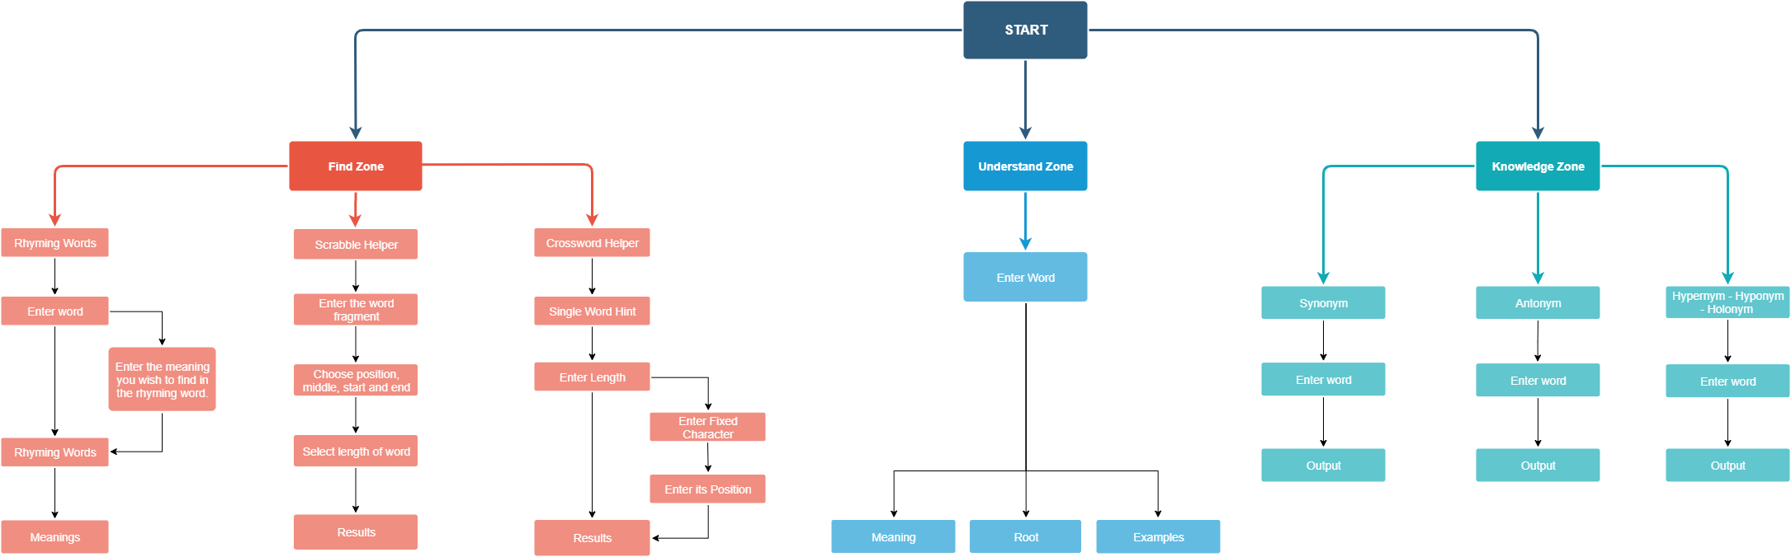
Modules and Detailed workflow

Slide 6
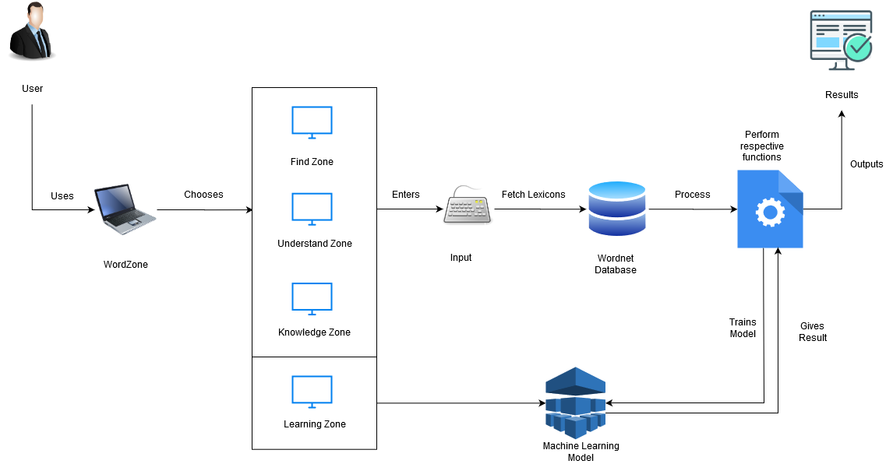
System Architecture:

Slide 7
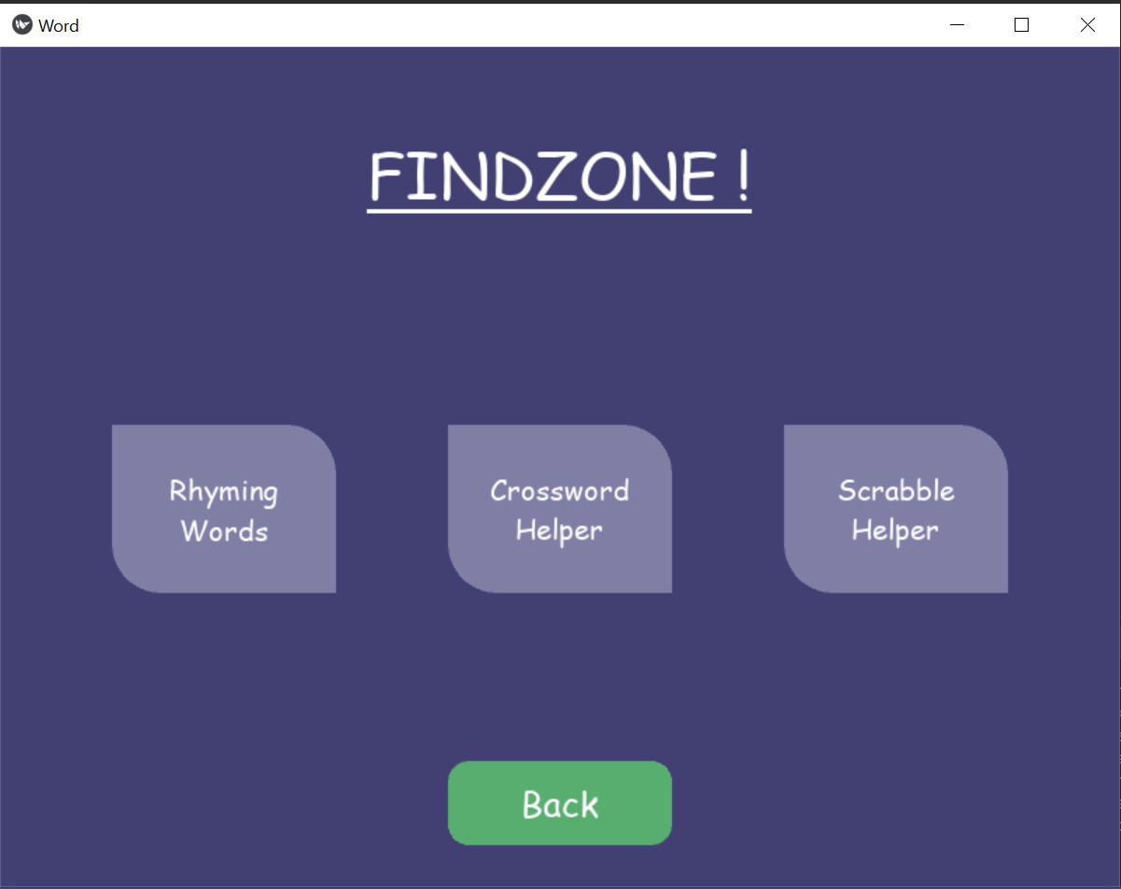
FINDZONE

Slide 8
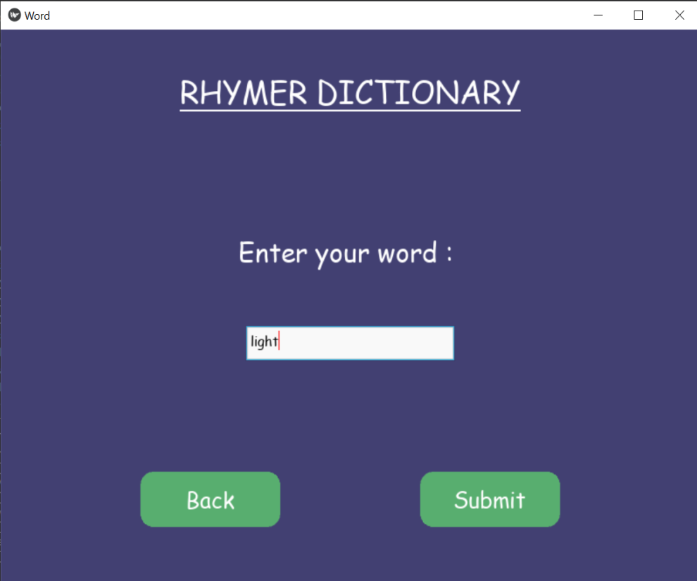
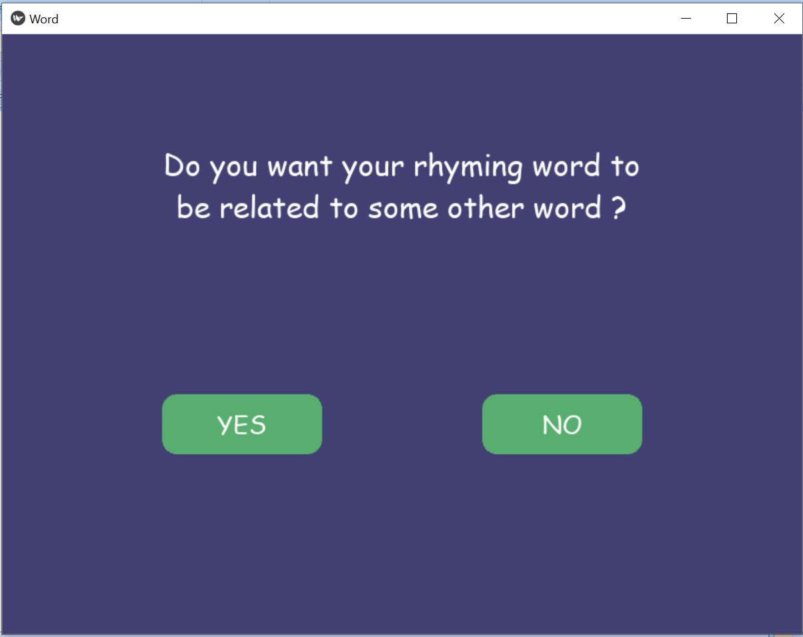
Rhyming Dictionary

Slide 10
Crossword Helper
User can enter a word nearest to their description
And the length of the word
The user receives a list of words, which they can narrow down by defining a particular character and its position.

Slide 11
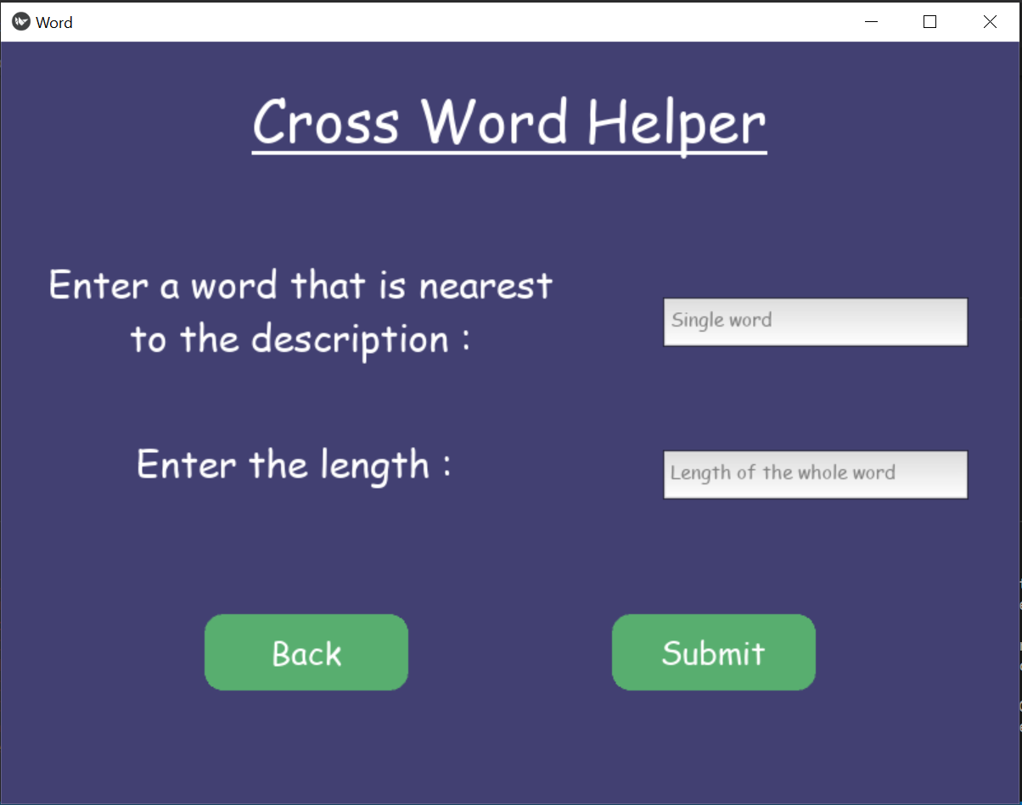
Crossword Helper
Notes:
https://www.boatloadpuzzles.com/playcrossword for solving crossword

Slide 12
Scrabble Helper
User can enter a word fragment they need in their word
They can also enter its position and length.

Slide 13
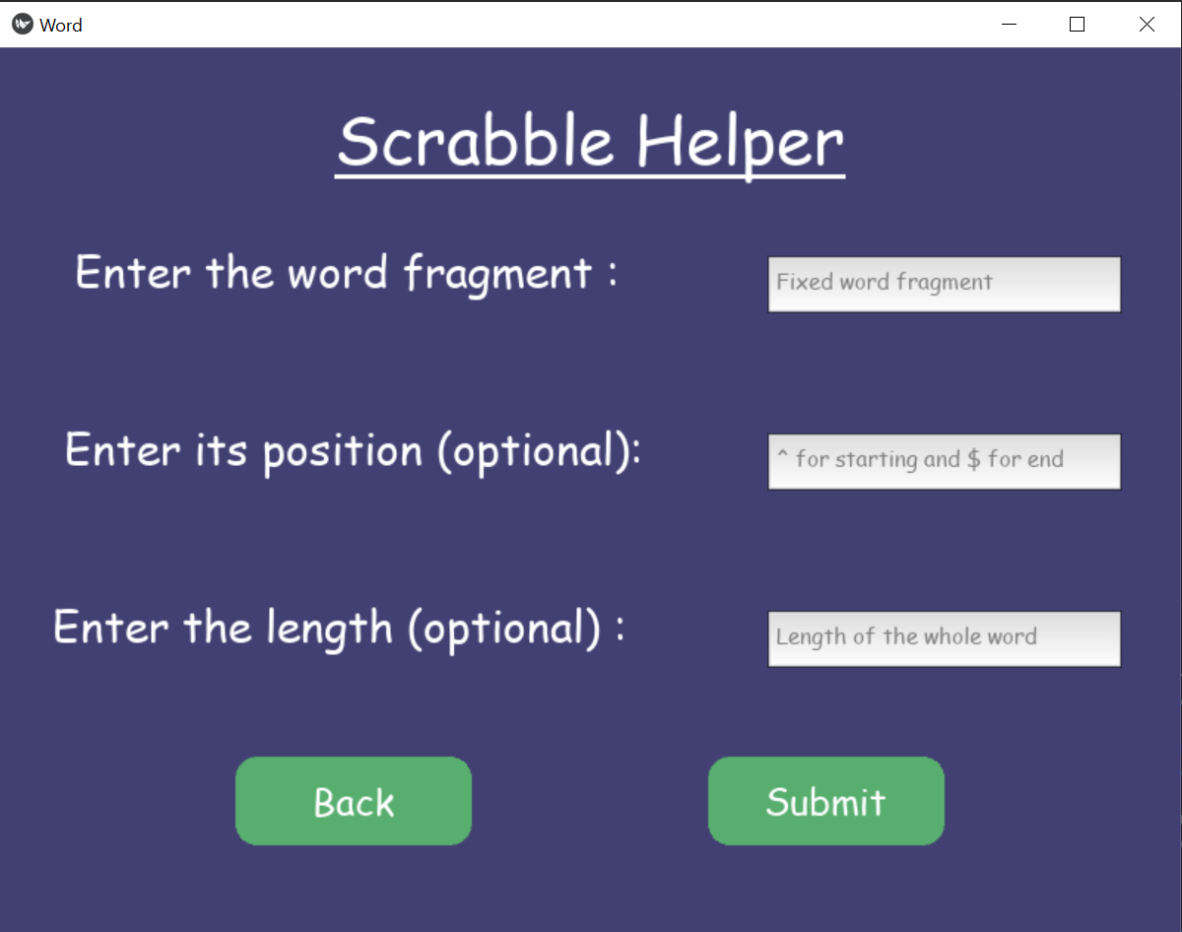
Scrabble Helper

Slide 14
Redefined Zones:

Slide 15
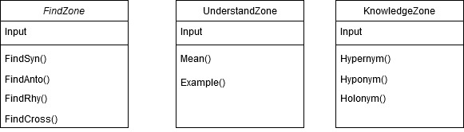
Redefined Zones:

Slide 16
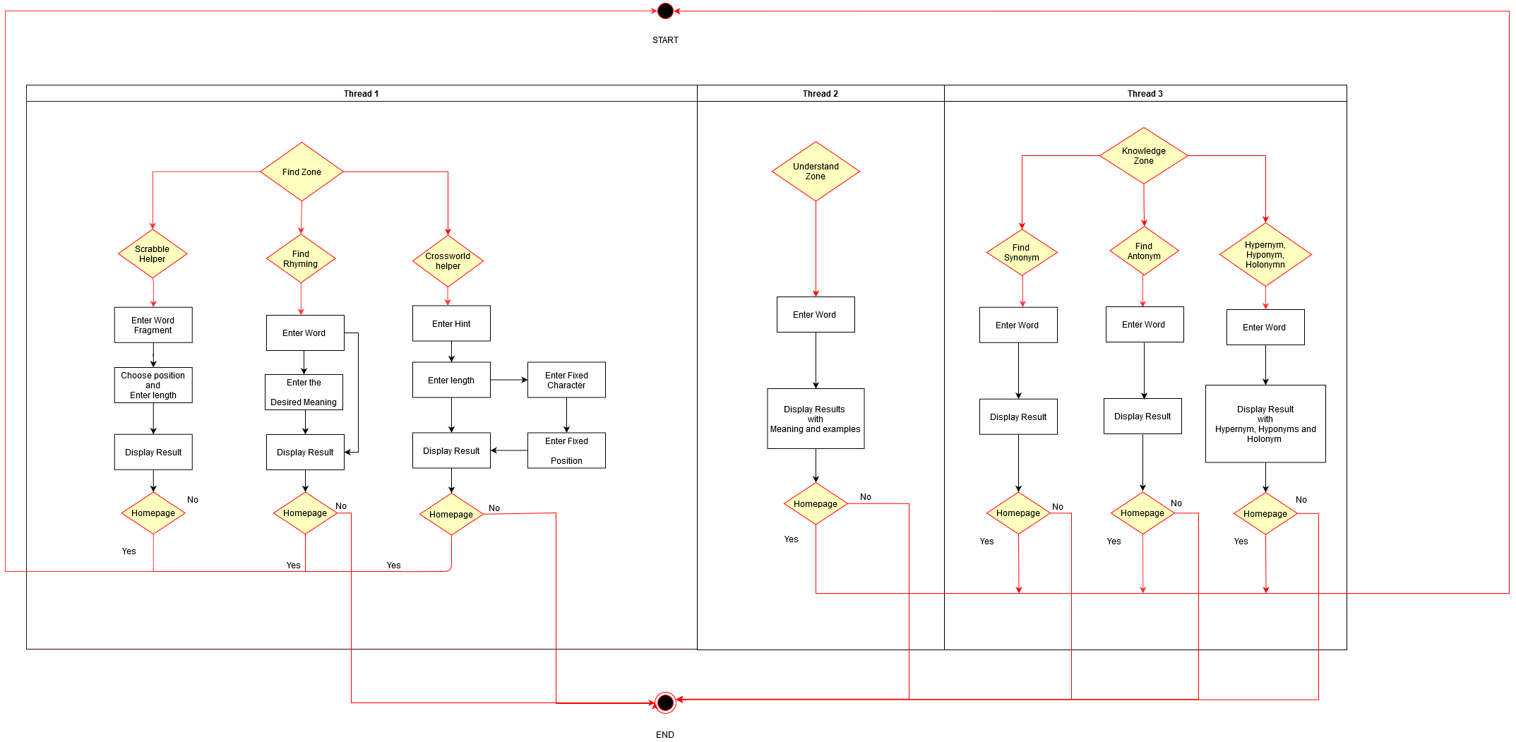
Redefined Zones:

Slide 17
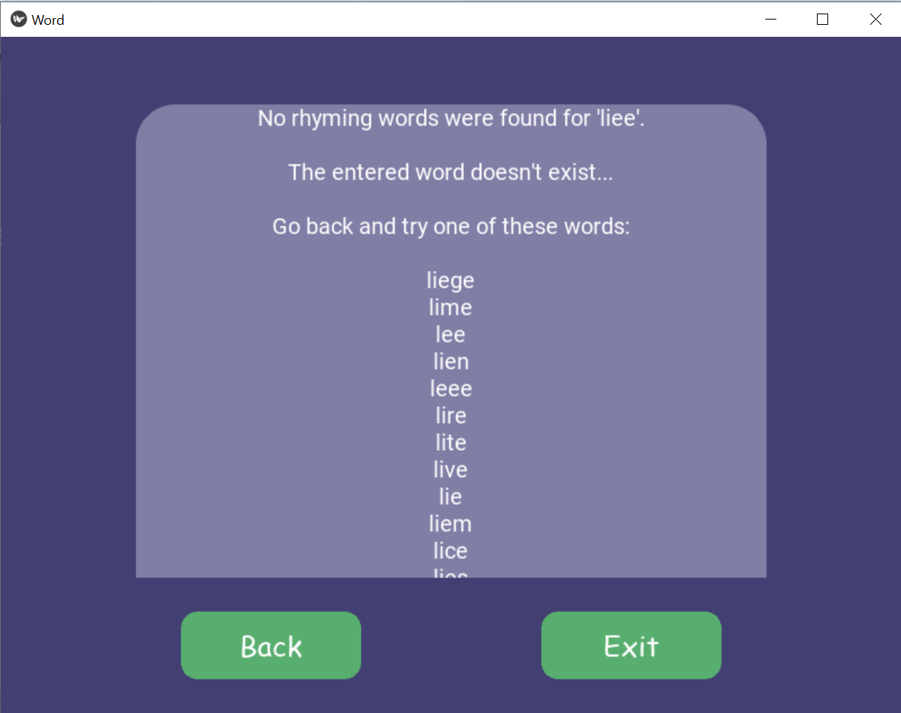
Spell Checker and suggestion for words

Slide 18
THANK YOU

